Slide 1
News and Notes
HW4 due now for all those not present
HW4 due Tuesday for those present
  please sign attendance sheet
  place HW in Prof. Kearns’ mailbox in CIS dept office, 3rd floor
No MK office hours today
  will hold some extended OHs next week, announce by email
Today:
  course review
  course evaluation

Slide 2
Course Review
Networked Life
CSE 112
Spring 2004
Prof. Michael Kearns

Slide 3
An Emerging Science
Examining apparent similarities between many human and technological systems & organizations
Importance of network effects in such systems
How things are connected matters greatly
Structure, asymmetry and heterogeneity
Details of interaction matter greatly
The metaphor of viral spread
Qualitative and quantitative; can be very subtle
A revolution of
  measurement
  theory
  breadth of vision

Slide 4
Course Vision and Mission
A network-centric examination of a wide range of social, technological, financial and political systems
Examined via the tools and metaphors of:
  Computer Science
  Economics
  Psychology and Sociology
  Mathematics
  Physics
Emphasize the common themes
Develop a new way of examining the world

Slide 5
Course Outline

Slide 6
The Networked Nature of Society
Networks as a collection of pairwise relations
Examples of familiar and important networks
  Social networks
  Content networks
  Technological networks
  Economic networks
The distinction between structure and dynamics
Network formation
A network-centric overview of modern society.

Slide 7
What is a Network?
A collection of individual or atomic entities
Referred to as nodes or vertices
Collection of links or edges between vertices
Links represent pairwise relationships
Links can be directed or undirected
Network: entire collection of nodes and links
Extremely general, but not everything:
  actors appearing in the same film
  lose information by pairwise representation
We will be interested in properties of networks
  often statistical properties of families of networks

Slide 8
“Real World” Social Networks
Example: Acquaintanceship networks
  vertices: people in the world
  links: have met in person and know last names
  hard to measure
  let’s do our own Gladwell estimate
Example: scientific collaboration
  vertices: math and computer science researchers
  links: between coauthors on a published paper
  Erdos numbers : distance to Paul Erdos
  Erdos was definitely a hub or connector; had 507 coauthors
  MK’s Erdos number is 3, via Mansour → Alon → Erdos
  how do we navigate in such networks?

Slide 9
Content Networks
Example: document similarity
  vertices: documents on the web
  links: defined by document similarity (e.g. Google)
  here’s a very nice visualization
  not the web graph, but an overlay content network
Of course, every good scandal needs a network
  vertices: CEOs, spies, stock brokers, other shifty characters
  links: co-occurrence in the same article
Then there are conceptual networks
  vertices: concepts to be discussed in NW Life
  links: arbitrarily determined by Prof. Kearns
Update: here are two more examples [thanks Hanna Wallach!]
  a thesaurus defines a network
  so do the interactions in a mailing list

Slide 10
Contagion, Tipping and Networks
Epidemic as metaphor
The three laws of Gladwell:
  Law of the Few (connectors in a network)
  Stickiness (power of the message)
  Power of Context
The importance of psychology
Perceptions of others; interdependence and tipping
Paul Revere, Sesame Street, Broken Windows, the Appeal of Smoking, and Suicide Epidemics
Informal case studies from social behavior and pop culture.

Slide 11
Key Characteristics of Tipping
Contagion:
  “viral” spread of disease, ideas, knowledge, etc.
  spread is determined by network structure
  network topology will influence outcomes
    who gets “infected”, infection rate, number infected
Amplification of the incremental:
  small changes can have large, dramatic effects
    network topology, infectiousness, individual behavior
Sudden, not gradual change:
  phase transitions and non-linear phenomena

Slide 12
Three Sources of Tipping
The Law of the Few (Messengers):
  Connectors, Mavens and Salesman
  Hubs and Authorities
The Stickiness Factor (Message):
  The “infectiousness” of the “message” itself
The Power of Context:
  global influences affecting messenger behavior

Slide 13
The Strength of Weak Ties
Not all links are of equal importance
Granovetter 1974: study of job searches
  56% found current job via a personal connection
  of these, 16.7% saw their contact “often”
  the rest saw their contact “occasionally” or “rarely”
Your “closest” contacts might not be the most useful
  similar backgrounds and experience
  they may not know much more than you do
  connectors derive power from a large fraction of weak ties
Further evidence in Dodds et al. paper
T&M, Granovetter, Gladwell: multiple “spaces” & “distances”
  geographic, professional, social, recreational, political,…
  We can reason about general principles without precise measurement

Slide 14
Introduction to Graph Theory
Networks of vertices and edges
Graph properties:
  cliques, independent sets, connected components, cuts, spanning trees,…
  social interpretations and significance
Special graphs:
  bipartite, planar, weighted, directed, regular,…
Computational issues at a high level
Beginning to quantify our ideas about networks.

Slide 15
Social Network Theory
Metrics of social importance in a network:
  degrees, closeness, between-ness,…
Local and long-distance connections
SNT “universals”
  small diameter
  clustering
  heavy-tailed distributions
Network formation
  random graph models
  preferential attachment
  affiliation networks
Examples from society, technology and fantasy
A statistical application of graph theory to human organization.

Slide 16
A “Canonical” Natural Network has…
Few connected components:
  often only 1 or a small number independent of network size
Small diameter:
  often a constant independent of network size (like 6)
  or perhaps growing only logarithmically with network size
  typically exclude infinite distances
A high degree of clustering:
  considerably more so than for a random network
  in tension with small diameter
A heavy-tailed degree distribution:
  a small but reliable number of high-degree vertices
  quantifies Gladwell’s connectors
  often of power law form
Notes:
MIGHT GIVE REAL EXAMPLES HERE? FROM WATTS?

Slide 17
Some Models of Network Generation
Random graphs (Erdos-Renyi models):
  gives few components and small diameter
  does not give high clustering and heavy-tailed degree distributions
  is the mathematically most well-studied and understood model
Watts-Strogatz and related models:
  give few components, small diameter and high clustering
  does not give heavy-tailed degree distributions
Preferential attachment:
  gives few components, small diameter and heavy-tailed distribution
  does not give high clustering
Hierarchical networks:
  few components, small diameter, high clustering, heavy-tailed
Affiliation networks:
  models group-actor formation
Nothing “magic” about any of the measures or models

Slide 18
Heavy-tailed Distributions
Pareto or power law distributions:
  for variables assuming integer values > 0
  probability of value x ~ 1/x^α
  typically 0 < α < 2; smaller α gives heavier tail
  here are some examples
  sometimes also referred to as being scale-free
For binomial, normal, and Poisson distributions the tail probabilities approach 0 exponentially fast
Inverse polynomial decay vs. inverse exponential decay
What kind of phenomena does this distribution model?
What kind of process would generate it?

Slide 19
Recap
Model G(N,p):
  select each of the possible edges independently with prob. p
  expected total number of edges is pN(N-1)/2
  expected degree of a vertex is p(N-1)
  degree will obey a Poisson distribution (not heavy-tailed)
Model G(N,m):
  select exactly m of the N(N-1)/2 edges to appear
  all sets of m edges equally likely
Graph process model:
  starting with no edges, just keep adding one edge at a time
  always choose next edge randomly from among all missing edges
Threshold or tipping for (say) connectivity:
  fewer than m(N) edges → graph almost certainly not connected
  more than m(N) edges → graph almost certainly is connected
  made formal by examining limit as N → infinity

Slide 20
Formalizing Tipping:
Thresholds for Monotone Properties
Consider Erdos-Renyi G(N,m) model
  select m edges at random to include in G
Let P be some monotone property of graphs
  P(G) = 1 → G has the property
  P(G) = 0 → G does not have the property
Let m(N) be some function of NW size N
  formalize idea that property P appears “suddenly” at m(N) edges
Say that m(N) is a threshold function for P if:
  let m’(N) be any function of N
  look at ratio r(N) = m’(N)/m(N) as N → infinity
  if r(N) → 0: probability that P(G) = 1 in G(N,m’(N)): → 0
  if r(N) → infinity: probability that P(G) = 1 in G(N,m’(N)): → 1
A purely structural definition of tipping
  tipping results from incremental increase in connectivity

Slide 21
So Which Properties Tip?
Just about all of them!
The following properties all have threshold functions:
  having a “giant component”
  being connected
  having a perfect matching (N even)
  having “small” diameter
Demo: look at the following progression
  giant component → connectivity → small diameter
  in graph process model (add one new edge at a time)
  [example 1] [example 2] [example 3] [example 4] [example 5]
With remarkable consistency (N = 50):
  giant component ~ 40 edges, connected ~ 100, small diameter ~ 180

Slide 22
The Clustering Coefficient of a Network
Let nbr(u) denote the set of neighbors of u in a graph
  all vertices v such that the edge (u,v) is in the graph
The clustering coefficient of u:
  let k = |nbr(u)| (i.e., number of neighbors of u)
  choose(k,2): max possible # of edges between vertices in nbr(u)
  c(u) = (actual # of edges between vertices in nbr(u))/choose(k,2)
  0 <= c(u) <= 1; measure of cliquishness of u’s neighborhood
Clustering coefficient of a graph:
  average of c(u) over all vertices u
k = 4
choose(k,2) = 6
c(u) = 4/6 = 0.666…

Slide 23
Caveman and Solaria
Erdos-Renyi:
  sharing a common neighbor makes two vertices no more likely to be directly connected than two very “distant” vertices
  every edge appears entirely independently of existing structure
But in many settings, the opposite is true:
  you tend to meet new friends through your old friends
  two web pages pointing to a third might share a topic
  two companies selling goods to a third are in related industries
Watts’ Caveman world:
  overall density of edges is low
  but two vertices with a common neighbor are likely connected
Watts’ Solaria world
  overall density of edges low; no special bias towards local edges
  “like” Erdos-Renyi

Slide 24
Meanwhile, Back in the Real World…
Watts examines three real networks as case studies:
  the Kevin Bacon graph
  the Western states power grid
  the C. elegans nervous system
For each of these networks, he:
  computes its size, diameter, and clustering coefficient
  compares diameter and clustering to best Erdos-Renyi approx.
  shows that the best α-model approximation is better
  important to be “fair” to each model by finding best fit
Overall moral:
  if we care only about diameter and clustering, α is better than p

Slide 25
Preferential Attachment
Start with (say) two vertices connected by an edge
For i = 3 to N:
  for each 1 <= j < i, let d(j) be degree of vertex j (so far)
  let Z = Σ d(j) (sum of all degrees so far)
  add new vertex i with k edges back to {1,…,i-1}:
    i is connected back to j with probability d(j)/Z
Vertices j with high degree are likely to get more links!
“Rich get richer”
Natural model for many processes:
  hyperlinks on the web
  new business and social contacts
  transportation networks
Generates a power law distribution of degrees
  exponent depends on value of k

Slide 26
Finding Short Paths
Milgram’s experiment, Columbia Small Worlds, α-model…
  all emphasize existence of short paths between pairs
How do individuals find short paths
  in an incremental, next-step fashion
  using purely local information about the NW and location of target
This is not a structural question, but an algorithmic one
  statics vs. dynamics
Navigability may impose additional restrictions on model!
Briefly investigate two alternatives:
  variation on the α-model
  a “social identity” model

Slide 27
The Web as Network
Web structure and components
Web communities
Web search:
  hubs and authorities
  the PageRank algorithm
  redundancy and co-training
The algorithmic implications of network structure.

Slide 28
Five Easy Pieces
Authors did two kinds of breadth-first search:
  ignoring link direction → weak connectivity
  only following forward links → strong connectivity
They then identify five different regions of the web:
  strongly connected component (SCC):
    can reach any page in SCC from any other in directed fashion
  component IN:
    can reach any page in SCC in directed fashion, but not reverse
  component OUT:
    can be reached from any page in SCC, but not reverse
  component TENDRILS:
    weakly connected to all of the above, but cannot reach SCC or be reached from SCC in directed fashion (e.g. pointed to by IN)
  SCC+IN+OUT+TENDRILS form weakly connected component (WCC)
  everything else is called DISC (disconnected from the above)
  here is a visualization of this structure

Slide 29
The HITS System
(Hyperlink-Induced Topic Search)
Given a user-supplied query Q:
  assemble root set S of pages (e.g. first 200 pages by AltaVista)
  grow S to base set T by adding all pages linked (undirected) to S
  might bound number of links considered from each page in S
Now consider directed subgraph induced on just pages in T
For each page p in T, define its
  hub weight h(p); initialize all to be 1
  authority weight a(p); initialize all to be 1
Repeat “forever”:
  a(p) := sum of h(q) over all pages q → p
  h(p) := sum of a(q) over all pages p → q
  renormalize all the weights
This algorithm will always converge!
  weights computed related to eigenvectors of connectivity matrix
  further substructure revealed by different eigenvectors
Here are some examples

Slide 30
The PageRank Algorithm
Let’s define a measure of page importance we will call the rank
Notation: for any page p, let
  N(p) be the number of forward links (pages p points to)
  R(p) be the (to-be-defined) rank of p
Idea: important pages distribute importance over their forward links
So we might try defining
  R(p) := sum of R(q)/N(q) over all pages q → p
  can again define iterative algorithm for computing the R(p)
  if it converges, solution again has an eigenvector interpretation
  problem: cycles accumulate rank but never distribute it
The fix:
  R(p) := [sum of R(q)/N(q) over all pages q → p] + E(p)
  E(p) is some external or exogenous measure of importance
  some technical details omitted here (e.g. normalization)
Let’s play with the PageRank calculator

Slide 31
Emergence of Global from Local
Context, motivation and influence
The madness of crowds:
  thresholds and cascades
  mathematical models of tipping
  the market for lemons
  private preferences and global segregation
Begin to connect to classical issues
of human and societal behavior.

Slide 32
Global Conflict from Local Preferences
You can’t all sit in the back or front rows
You can’t all have too large a buffer zone
If you like sitting on the aisle, but don’t like being climbed over, you’ll probably be unhappy sooner or later
  e.g. by people who like sitting in the middle
You can’t have too many who are far from the crowd
You can’t all be in the back 1/3 with some behind you
Etc. etc. etc.
Everyone may have personal preferences that
  are rather mild
  can easily all be fulfilled with a small (or large) enough group
  but are collectively impossible with the current group size
The impossibility may be subtle and diffuse
  think of an overconstrained system of equations

Slide 33
Volleyball, Critical Mass and Tipping
Consider activities where the number who will participate depends on the (expected) number participating
Schelling’s examples: volleyball and seminars
  but also going to the movies, Internet downloads, voting,…
  “individuals” may be (e.g.) computer programs
May prefer crowds, solitude, or some precise balance
Different people may have different preferences
Dynamics can often be conceptualized in a diagram
To compute what will happen from a given starting point:
  go up to the curve from the starting point
  go from current point on curve horizontally (left or right) to diagonal
  go from diagonal vertically (up or down) back to curve
  keep repeating last two steps
Can get equilibria (stable or unstable), cycles (limited or not)

Slide 34
Local Preferences and Segregation
Special case of preferences: housing choices
Imagine individuals who are either “red” or “blue”
They live on in a grid world with 8 neighboring cells
Neighboring cells either have another individual or are empty
Individuals have preferences about demographics of their neighborhood
Here is a very nice simulator

Slide 35
An Introduction to Game Theory
Models of economic and strategic interaction
Notions of equilibrium
  Nash
  correlated
  cooperative
  market
  bargaining
Multi-player games
Social choice theory
A powerful mathematical model of what happens
over links in competitive and cooperative settings.

Slide 36
The World According to Nash
If > 2 actions, mixed strategy is a distribution on them
  e.g. 1/3 rock, 1/3 paper, 1/3 scissors
Might also have > 2 players
A general mixed strategy is a vector P = (P[1], P[2],… P[n]):
  P[i] is a distribution over the actions for player i
  assume everyone knows all the distributions P[j]
  but the “coin flips” used to select from P[i] known only to i
P is an equilibrium if:
  for every i, P[i] is a best response to all the other P[j]
Nash 1950: every game has a mixed strategy equilibrium
  no matter how many rows and columns there are
  in fact, no matter how many players there are
Thus known as a Nash equilibrium
A major reason for Nash’s Nobel Prize in economics

Slide 37
Board Games and Game Theory
What does game theory say about richer games?
  tic-tac-toe, checkers, backgammon, go,…
  these are all games of complete information with state
  incomplete information: poker
Imagine an absurdly large “game matrix” for chess:
  each row/column represents a complete strategy for playing
  strategy = a mapping from every possible board configuration to the next move for the player
  number of rows or columns is huge --- but finite!
Thus, a Nash equilibrium for chess exists!
  it’s just completely infeasible to compute it
  note: can often “push” randomization “inside” the strategy

Slide 38
Repeated Games
Nash equilibrium analyzes “one-shot” games
  we meet for the first time, play once, and separate forever
Natural extension: repeated games
  we play the same game (e.g. Prisoner’s Dilemma) many times in a row
  like a board game, where the “state” is the history of play so far
  strategy = a mapping from the history so far to your next move
So repeated games also have a Nash equilibrium
  may be different from the one-shot equilibrium!
  depends on the game and details of the setting
We are approaching learning in games
  natural to adapt your behavior (strategy) based on play so far

Slide 39
Correlated Equilibrium
In a Nash equilibrium (P[1],P[2]):
  player 2 “knows” the distribution P[1]
  but doesn’t know the “random bits” player 1 uses to select from P[1]
  equilibrium relies on private randomization
Suppose now we also allow public (shared) randomization
  so strategy might say things like “if private bits = 100110 and shared bits = 110100110, then play hawk”
Then two strategies are in correlated equilibrium if:
  knowing only your strategy and the shared bits, my strategy is a best response, and vice-versa
Nash is the special case of no shared bits

Slide 40
A More Complex Setting:
Bargaining
Convex set S of possible payoffs
Players must bargain to settle on a solution (x,y) in S
What “should” the solution be?
Want a general answer
A function F(S) mapping S to a solution (x,y) in S
Nash’s axioms for F:
  choose on red boundary (Pareto)
  scale invariance
  symmetry in the role of x and y
  “independence of irrelevant alternatives”:
    if green solution was contained in smaller red set, must also be red solution
y = payoff to player 2
possible
outcomes
x = payoff to player 1

Slide 41
Social Games on Networks:
Interdependent Security
Tragedies of the commons
Catastrophic events: you can only die once
Fire detectors, airline security, Arthur Anderson,…
Buying and selling on a network
Preferential attachment, price variation, and the distribution of wealth
Blending network, behavior and dynamics.

Slide 42
The Airline Security Problem
Imagine an expensive new bomb-screening technology
  large cost C to invest in new technology
  cost of a mid-air explosion: L >> C
There are two sources of explosion risk to an airline:
  risk from directly checked baggage: new technology can reduce this
  risk from transferred baggage: new technology does nothing
  transferred baggage not re-screened (except for El Al airlines)
This is a “game”…
  each player (airline) must choose between I(nvesting) or N(ot)
    partial investment ~ mixed strategy
  (negative) payoff to player (cost of action) depends on all others
…on a network
  the network of transfers between air carriers
  not the complete graph
  best thought of as a weighted network

Slide 43
The IDS Model
[Kunreuther and Heal]
Let x_i be the fraction of the investment C airline i makes
Define the cost of this decision x_i as:
  - (x_i C + (1 – x_i)p_i L + S_i L)
S_i: probability of “catching” a bomb from someone else
  a straightforward function of all the “neighboring” airlines j
  incorporates both their investment decision j and their probability or rate of transfer to airline i
Analysis of terms:
  x_i C = C at x_i = 1 (full investment); = 0 at x_i = 0 (no investment)
  (1-x_i)p_i L = 0 at full investment; = p_i L at no investment
  S_i L: has no dependence on x_i
What are the Nash equilibria?
  fully connected network with uniform transfer rates: full investment or no investment by all parties!

Slide 44
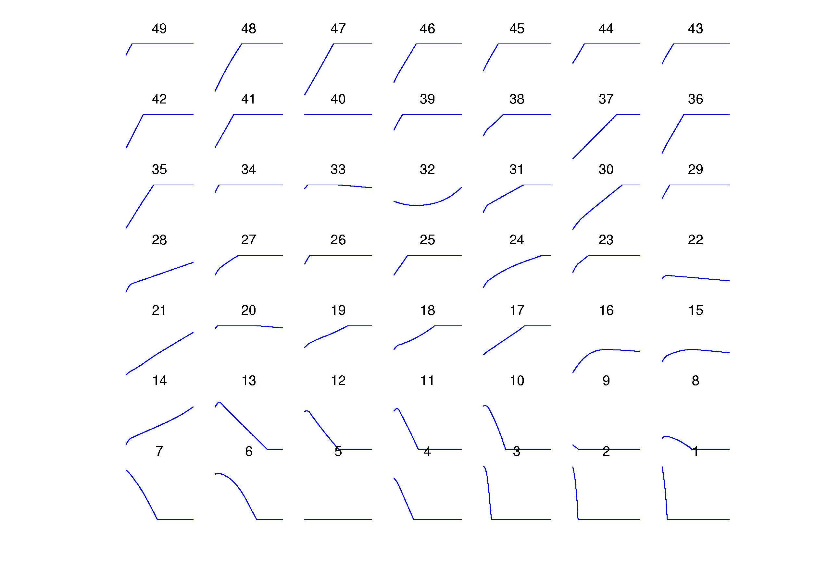
Results of Simulation
least busy carrier
investment →
sim time →
most busy carrier
Consistent convergence to a mixed equilibrium
Larger airlines do not invest at equilibrium!
Dynamics of influence in the network

Slide 45
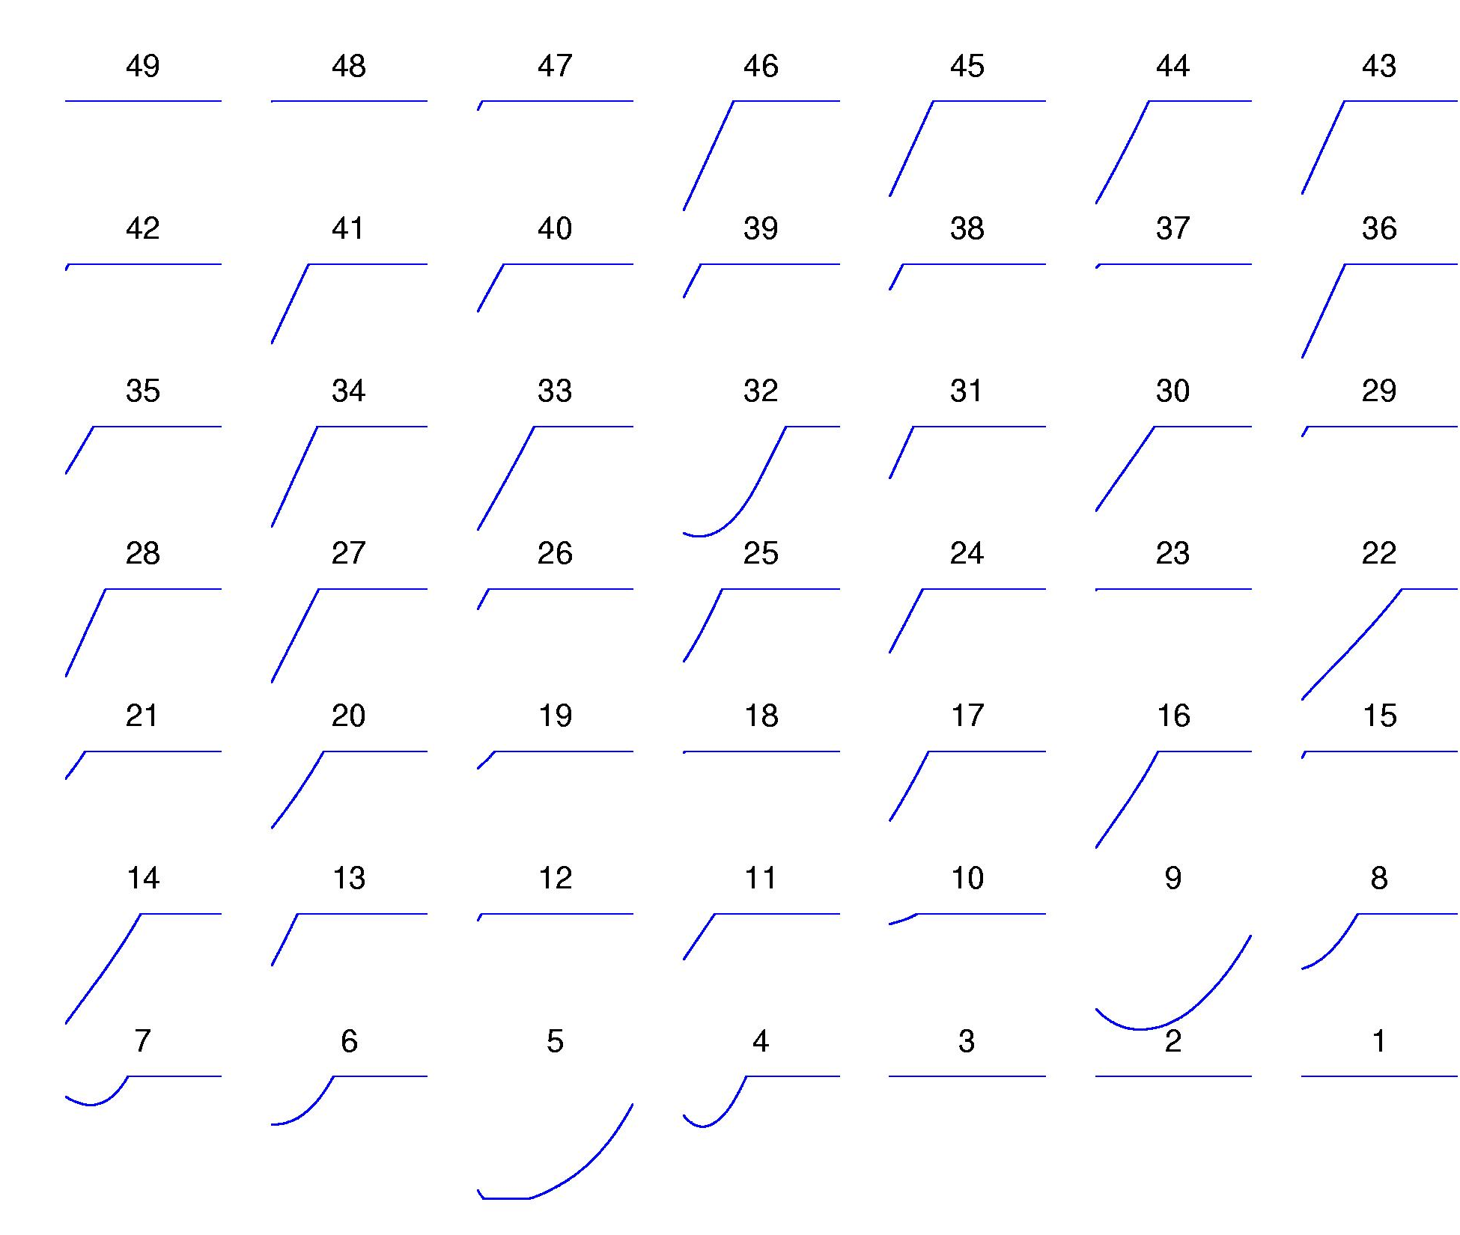
The Tipping Point
least busy carrier
Fix (subsidize) 3 largest airlines at full investment
Now consistently converge to global, full investment!
Largest 2 do not tip; cascading effects
Permits consideration of policy issues
most busy carrier

Slide 46
Behavioral Economics
What’s broken with game theory?
How should you split 10 dollars?
The return of context
Guilt and envy: fixing the theory
Controlled social psychology experiments
examining how “rational” we really are(n’t).

Slide 47
How People Ultimatum-Bargain
Thousands of games have been played in experiments…
In different cultures around the world
With different stakes
With different mixes of men and women
By students of different majors
Pretty much always, two things prove true:
Player 1 offers close to, but less than, half (40% or so)
Player 2 rejects low offers (20% or less)

Slide 48
Two Problems with Game Theory
Doesn’t explain the dictator game
Doesn’t explain ultimatum bargaining
Can it still help us outsmart people who don’t play game-theoretically?
Generally, no. It can only help us beat “rational” opponents — not real people.
Does adding something non-strategic like “altruism” fix these problems?
It had better fix the dictator game!
But it isn’t enough for ultimatum bargaining.

Slide 49
A New Theory of Utility
Consider that people still like their payoffs
They also dislike others having more money, with some coefficient α.
And they dislike having more money than others, with coefficient β.
U_1 is player 1’s utility; P_1 & P_2 are the players’ payoffs.
U_1 = P_1 - α(max[P_2 - P_1, 0]) - β(max[P_1 - P_2,0])
α is “envy”
β is “guilt”
0 <= β < 1 β < α
Different players can have different β and α

Slide 50
Subjective Randomization
People randomize better when they’re paid to be random
World RPS championship: probably a good entropy pool!
Binary random choices (simulating coin flips):
Often come up exactly 50/50
Have too few runs of identical choices: (n+1)/2 expected
Have longest runs that are too short (5 or 6 per 20)
Alternating (“negative recency”) is a common artifact
Oddly, children seem to learn this around grade 5!

Slide 51
Market Economies and Networks

Slide 52
Mathematical Economics
Have k abstract goods or commodities g1, g2, … , gk
Have n consumers or players
Each player has an initial endowment e = (e1,e2,…,ek) > 0
Each consumer has their own utility function:
  assigns a personal valuation or utility to any amounts of the k goods
  e.g. if k = 4, U(x1,x2,x3,x4) = 0.2*x1 + 0.7*x2 + 0.3*x3 + 0.5*x4
  here g2 is my “favorite” good --- but it might be expensive
  generally assume utility functions are insatiable
    always some bundle of goods you’d prefer more
  utility functions not necessarily linear, though

Slide 53
Market Equilibrium
Suppose we post prices p = (p1,p2,…,pk) for the k goods
Assume consumers are rational:
  they will attempt to sell their endowment e at the prices p (supply)
  if successful, they will get cash e*p = e1*p1 + e2*p2 + … + ek*pk
  with this cash, they will then attempt to purchase x = (x1,x2,…,xk) that maximizes their utility U(x) subject to their budget (demand)
  example:
    U(x1,x2,x3,x4) = 0.2*x1 + 0.7*x2 + 0.3*x3 + 0.5*x4
    p = (1.0,0.35,0.15,2.0)
    look at “bang for the buck” for each good i, wi/pi:
      g1: 0.2/1.0 = 0.2; g2: 0.7/0.35 = 2.0; g3: 0.3/0.15 = 2.0; g4: 0.5/2.0 = 0.25
      so we will purchase as much of g2 and/or g3 as we can subject to budget
Say that the prices p are an equilibrium if there are exactly enough goods to accomplish all supply and demand steps
That is, supply exactly balances demand --- market clears

Slide 54
A Network Model of
Market Economies
Still begin with the same framework:
  k goods or commodities
  n consumers, each with their own endowments and utility functions
But now assume an undirected network dictating exchange
  each vertex is a consumer
  edge between i and j means they are free to engage in trade
  no edge between i and j: direct exchange is forbidden
Note: can “encode” network in goods and utilities
  for each raw good g and consumer i, introduce virtual good (g,i)
  think of (g,i) as “good g when sold by consumer i”
  consumer j will have
    zero utility for (g,i) if no edge between i and j
    j’s original utility for g if there is an edge between i and j

Slide 55
Network Equilibrium
Now prices are for each (g,i), not for just raw goods
  permits the possibility of variation in price for raw goods
  prices of (g,i) and (g,j) may differ
  what would cause such variation at equilibrium?
Each consumer must still behave rationally
  attempt to sell all of initial endowment, but only to NW neighbors
  attempt to purchase goods maximizing utility within budget
  will only purchase g from those neighbors with minimum price for g
Market equilibrium still always exists!
  set of prices (and consumptions plans) such that:
    all initial endowments sold (no excess supply)
    no consumer has money left over (no excess demand)

Slide 56
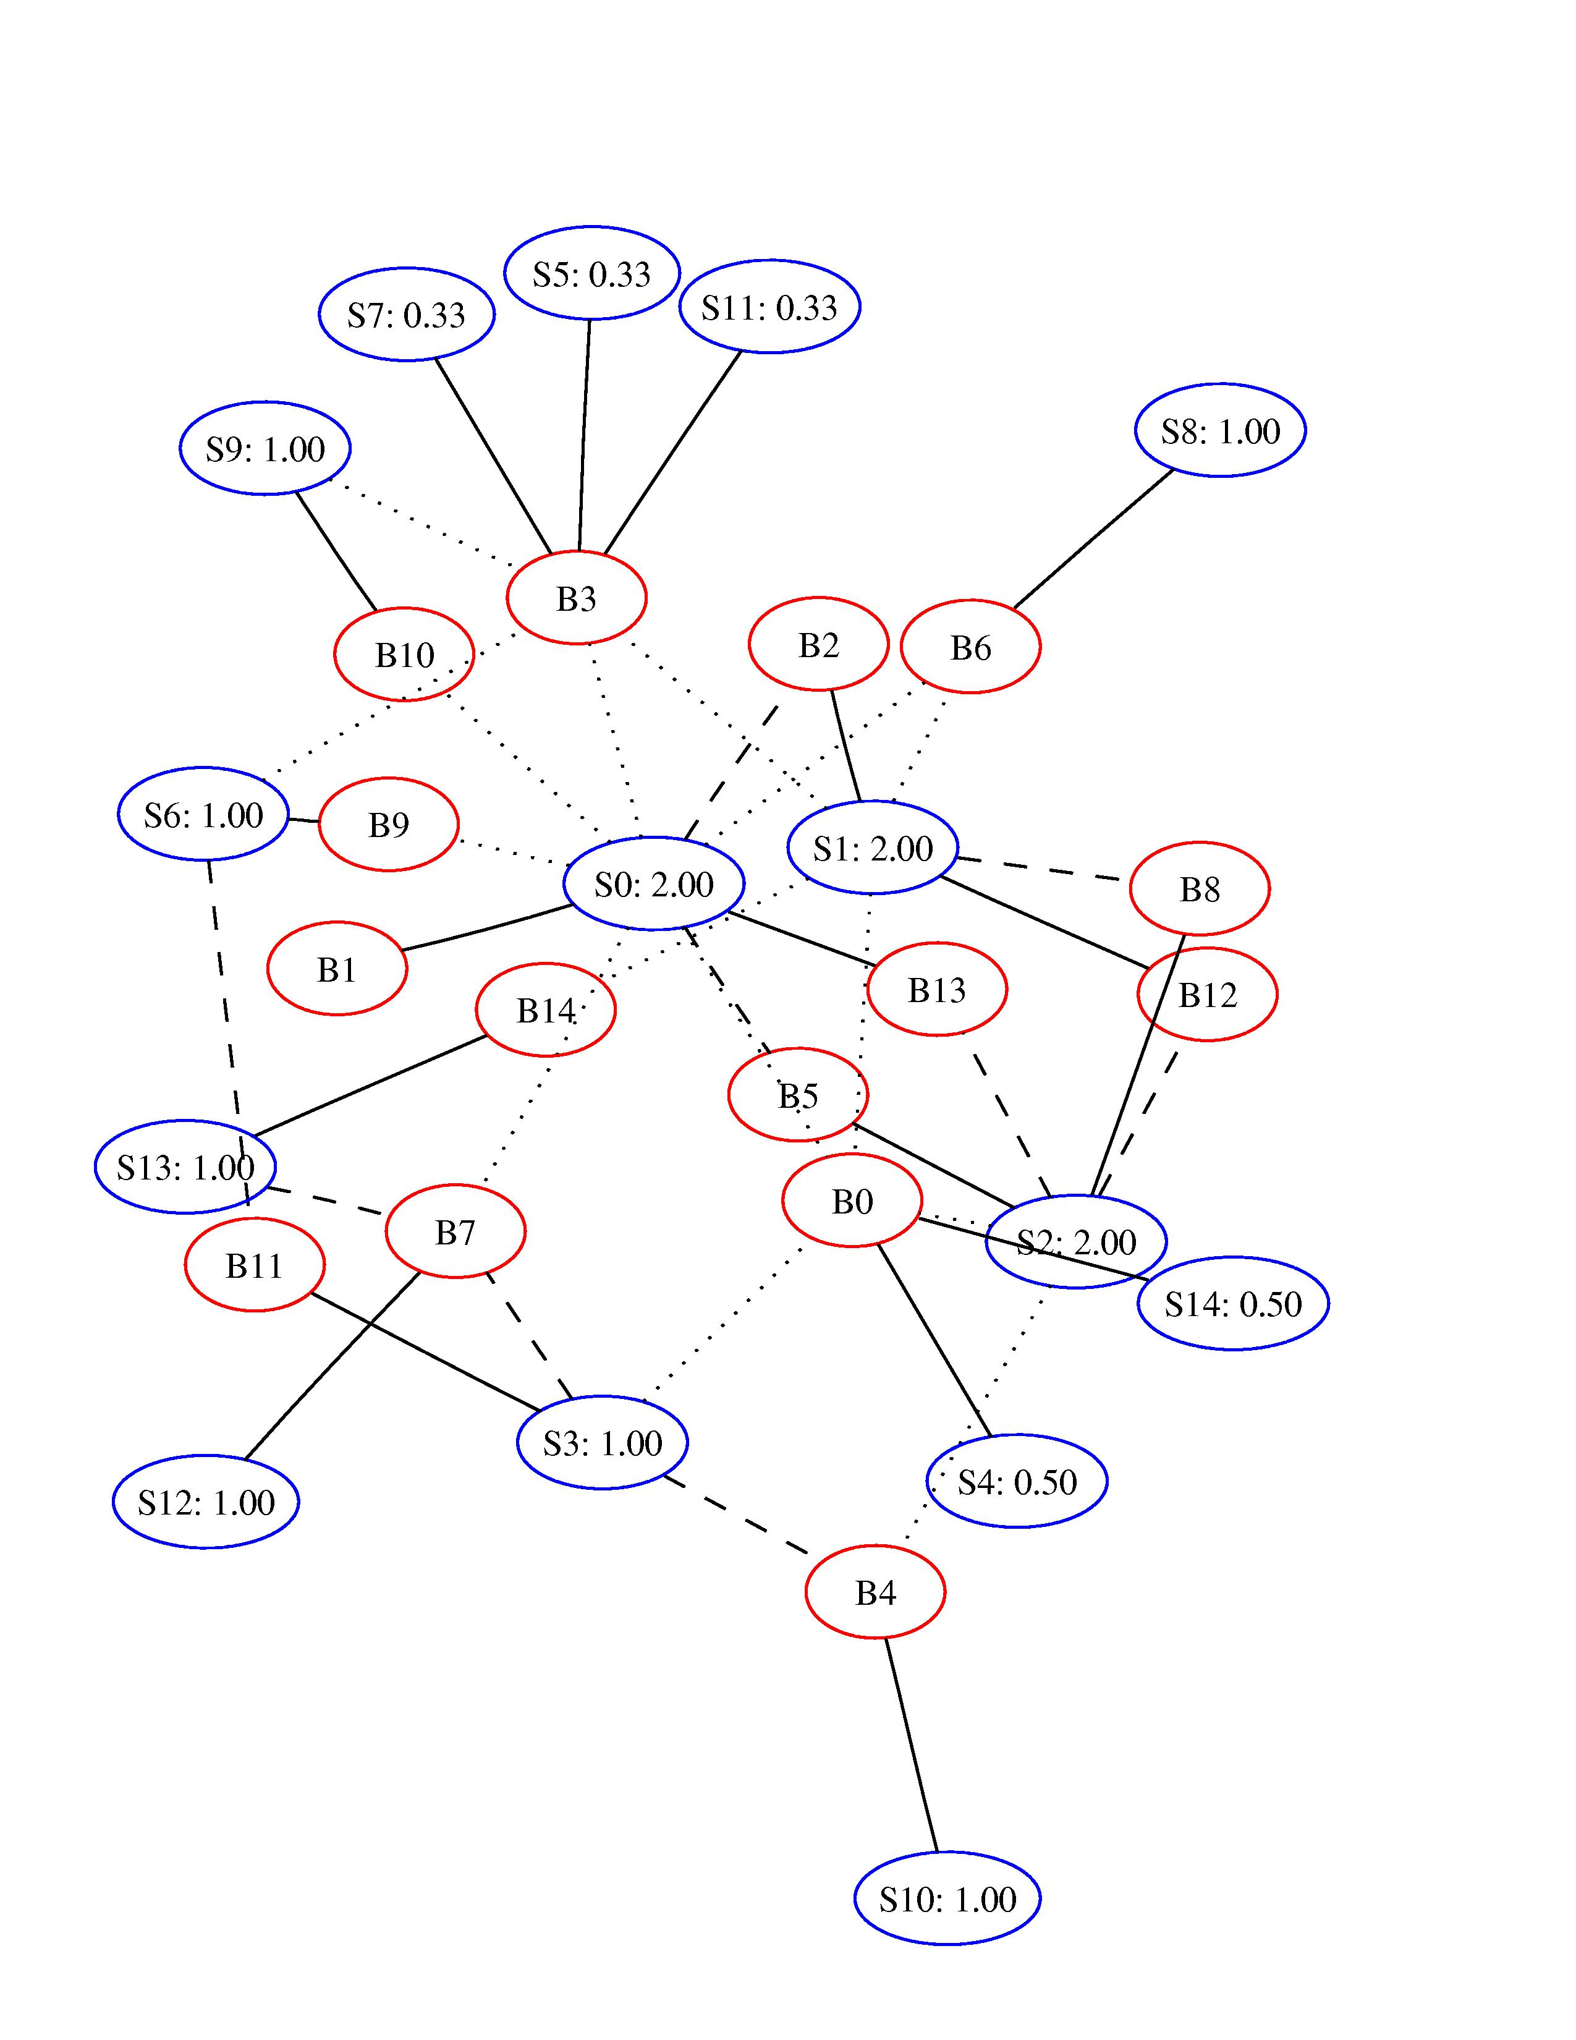
A Sample Network and Equilibrium
Solid edges:
  exchange at equilibrium
Dashed edges:
  competitive but unused
Dotted edges:
  non-competitive prices
Note price variation
  0.33 to 2.00
Degree alone does not determine price!
  e.g. B2 vs. B11
  e.g. S5 vs. S14

Slide 57
Evolutionary Game Theory
Fitness and evolutionary dynamics
Mimicking and replicating vs. optimizing
Evolutionary stable strategies
The evolution of cooperation
Replication and viral spread
From economics to biology, and back again

Slide 58
Evolution Without Biology
Darwinian dynamics:
  large population of individuals
  interacting with each other and their environment
  given population and environment, an abstract measure of “fitness”
    fitness is a property of individuals
    measures how well-suited the individual is to current conditions
    e.g. it’s good to be furry in cold weather
    it’s good to be a hawk if there are lots of doves around
  assume individuals replicate according to their fitness
  can also incorporate processes of mutation, crossover, etc.
  so in cold climates “next generation” of population will be furrier
So “unfit” properties or strategies can die out over time
Note: can also apply to many non-biological settings
  e.g. to the survival/propagation of ideas (mimetics)
  it’s good to be a simple, comforting idea in troubled times
  to the development of technology, companies,…
  thefacebook = Friendster + mutation?
How can we marry this broad framework with game theory?

Slide 59
Evolutionary Stable Strategies
An evolutionary notion of equilibrium
Want to capture idea that population profile of strategies is stable
Let p be the probability that a randomly chosen player plays hawk:
  draw individual x at random → Pr[hawk] = p_x
  flip coin with bias p_x;
  over draw of both x and coin flip, what’s the probability of hawk?
Now suppose a small fraction e of “mutants” is injected
  mutants all play hawk with probability q <> p
New population probability of playing hawk:
  p’ = (1-e)p + eq
We call p an ESS if for any q, the population Pr[hawk] will return to p, as long as the invasion fraction e is small enough
  so the mutants will die out under evolutionary dynamics
Hawks and Doves:
  fraction V/C of pure hawks, 1 – V/C of pure doves is ESS

Slide 60
The EGT Applet
Many thanks to Ben Packer and Nick Montfort
  applet installation, NW version, strategy language, cool examples,…
Applet simulates EGT dynamics for repeated games
Repeated game strategies are history-dependent
Can (and will) program our own strategies (Thursday!)
Basic usage:
  choose game matrix and collection of strategies in initial population
  choose number of rounds in each repeated-game meeting
  applet shows “tournament score” for each strategy
    overall fitness against an population evenly divided among strategies
    of course, highest tournament score is no guarantee of survival!
    because the population fractions will change with time
  choose initial population fractions for each strategy
  choose network structure
    which strategies compete with which others
  applet simulates evolution dynamics
    shows fraction of each strategy in population over time
Now let’s go to the applet

Slide 61
Internet Economics
Selfish routing
The Price of Anarchy
Peer-to-peer as competitive economy
Paris Metro Pricing for QoS
Economic views of network security
The collision of network, economics,
algorithms, content, and society.

Slide 62
Competition in the Internet
You and I both want to download the Starr report
  I’d like to get the material as quickly as possible; so would you
  connectivity to the hosting server is a finite resource
  we’re in competition
I want to watch “The Matrix” in streaming high-res video
  you just want to read your email
  real-time arrival of packets is important to me; not to you
  I might be willing to pay more for “priority service” packet delivery
Many of us want to watch “The Matrix” (multicast)
  those of “near” each other (e.g. Penn) might share costs
    share common route from source until final hop
  some parties might be more isolated
    e.g. lone Wyoming Tech grad student
    his route has little overlap with anyone else
  how should we pay?

Slide 63
Case Study: Selfish Routing
Standard Internet routing:
  route your traffic follows entirely determined by routing tables
  out of your control
  generally based on shortest paths, not current congestion!
Source routing:
  you specify in the packet header the exact sequence of routers
  better be a legitimate path!
  in principle, can choose path to avoid congested routers
Source routing as a game:
  traffic desiring to go from A to B (a flow) viewed as a player
    number of players = number of flows (huge)
  actions available to a flow: all the possible routes through the NW
    number of actions = number of routes (huge)
  penalty to a flow following a particular route: latency in delivery
  rationality: if flow can get lower latency on a different route, it will!
Let’s look at T. Roughgarden’s excellent slides on the topic
  we will examine the material in pages 1-23

Slide 64
Closing Remarks
Thanks Nick and Kilian!
Thanks to all of you!
Course evaluations
  any and all feedback appreciated
  must use number 2 pencil (provided)
  volunteer to collect forms and immediately take to CIS office
Good luck on the final (Monday May 3 11 AM here)
Have a great summer!

